Slide 1
Tripping
on Aesthetascs
Effects of Thermal Stress on Olfactory Cue Reception in H. oregonensis
Eli, Maya, Oliver, and Sidney

Slide 2
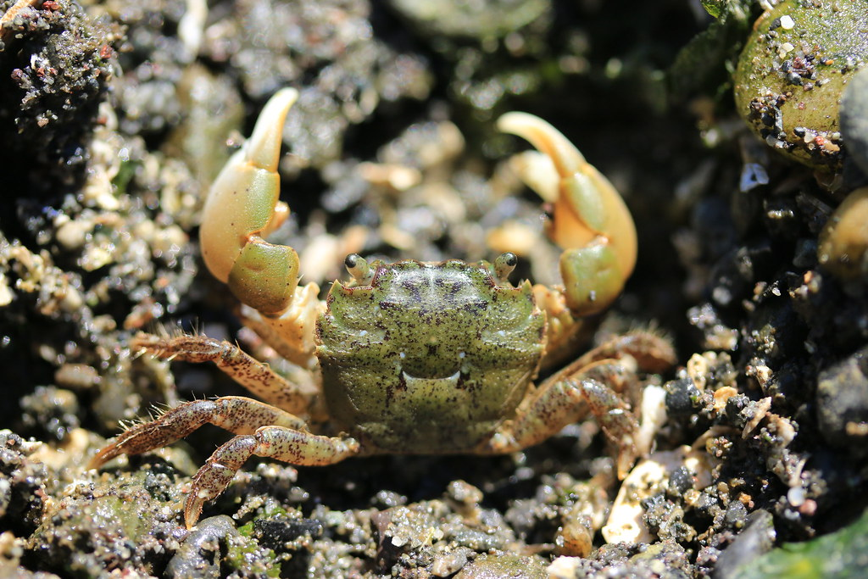
Introduction:
Hemigrapsus oregonensis
Native to the Pacific Northwest coast
Intertidal species used to high variation in their living conditions
pH
Temperature
Moisture
Salinity
Act as a predator species and a prey species
Good reference organism

Slide 3
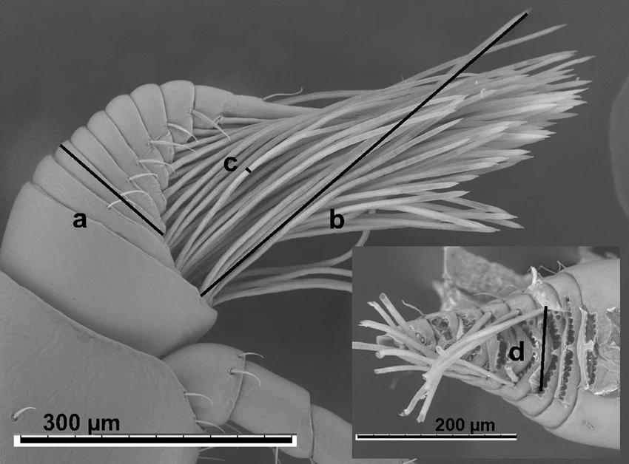
Introduction:
Hemigrapsus oregonensis
They use chemoreception to understand their surroundings
Food
Predator detection
Chemical signals are processed from the water
They are sensitive to changes in pH
Scanning electron micrograph of side view of Hemigrapsus oregonensis antennule (inset: front view with aesthetascs removed) with morphometric measurements indicated by letter: (a) antennule side (thickness); (b) aesthetasc length; (c) aesthetasc diameter; (d) array width.
Notes:
https://www.researchgate.net/figure/Scanning-electron-micrograph-of-side-view-of-Hemigrapsus-oregonensis-antennule-inset_fig1_237200292
Scanning electron micrograph of side view of Hemigrapsus oregonensis antennule (inset: front view with aesthetascs removed) with morphometric measurements indicated by letter: (a) antennule side (thickness); (b) aesthetasc length; (c) aesthetasc diameter; (d) array width.

Slide 4
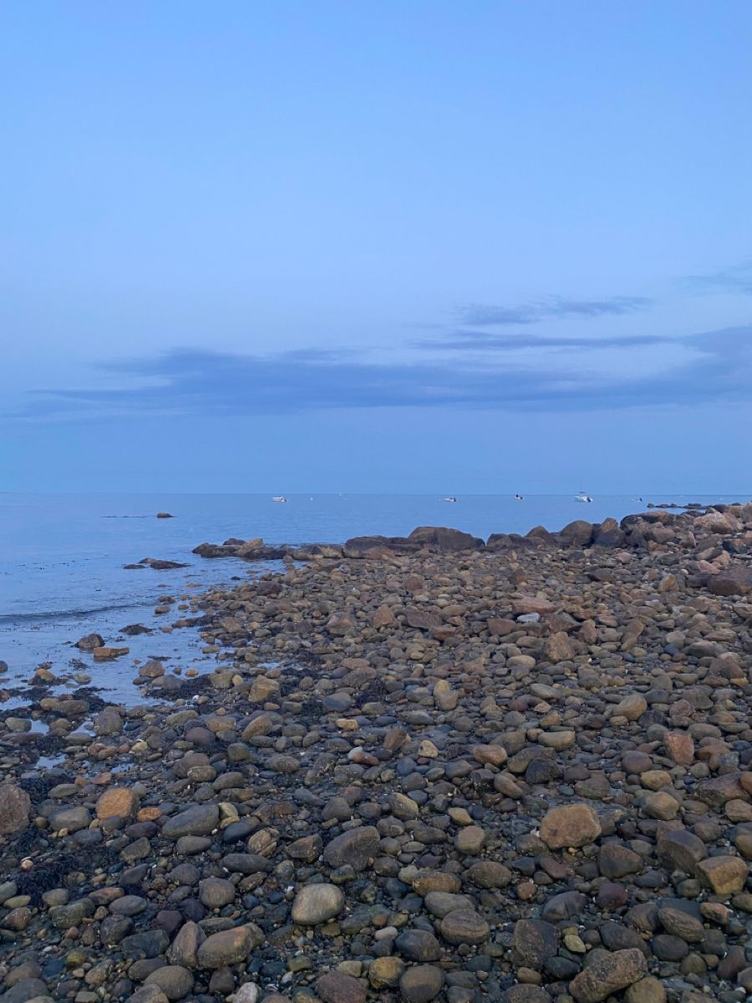
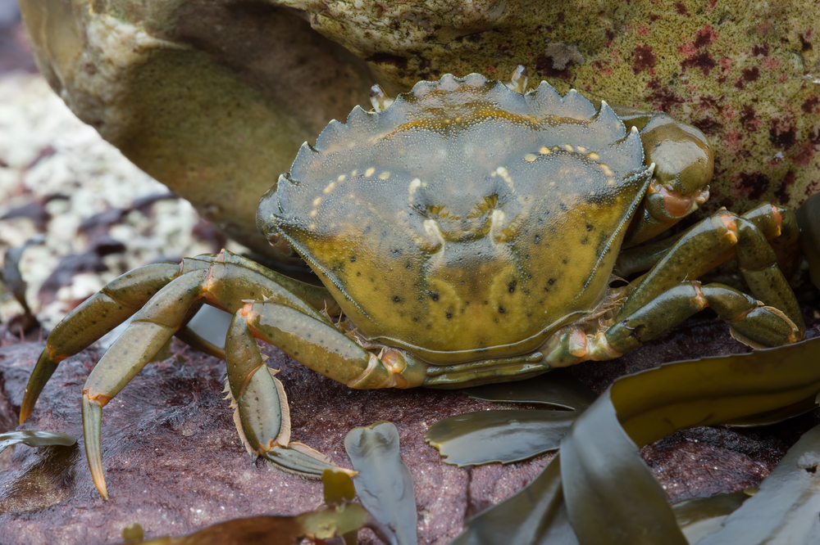
Introduction:
Hemigrapsus oregonensis
They now have an invasive competitor for their niche
Carcinus maenas
Invasive crab taking over their habitat
New predator to the shore crab
Global change also affecting the conditions of their habitat
pH
Temperature
Habitat loss

Slide 5
Methods:
2 testing groups:
6 H. oregonensis in control group (14C) 6 H. oregonensis in treatment (24C)
Performed resazurin assay weekly (total of three times)

Slide 6
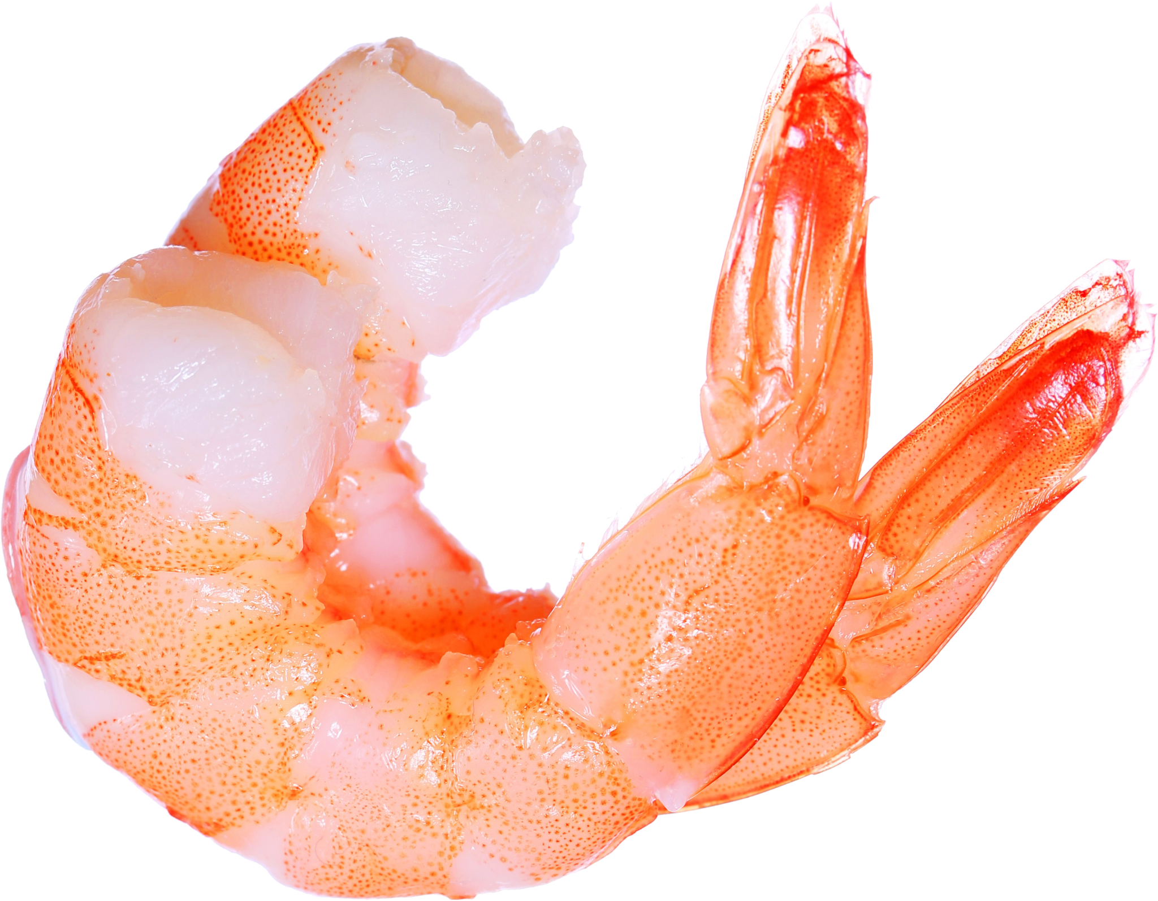
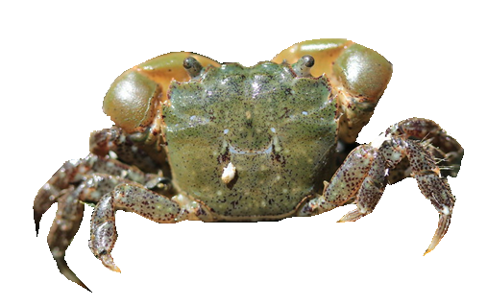
Methods: Food cues
Designed a maze to break line of sight to food
Placed subjects in maze without food, allowed them to adjust to testing chamber for one minute
Added food to opposite side of maze and timed how long it took subjects to find food
Subjects that did not find the food within five minutes were considered to have failed

Slide 7
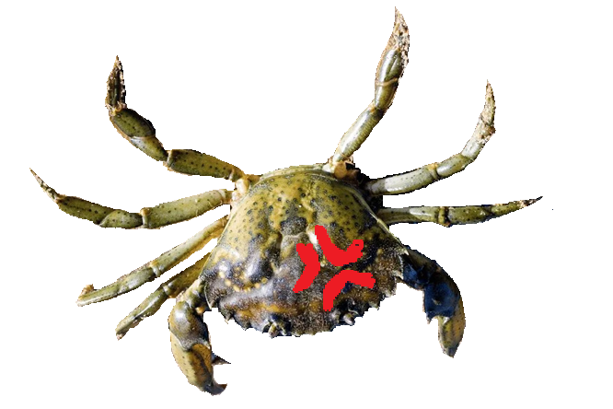
Methods: Predator cues
Testing chamber was designed to break line of sight to the potential predator, but allow water flow between the two sections
Subjects were placed in testing chamber and allowed one minute to adjust before green crabs were added to the opposite partition
Filmed subject response for one minute, then later processed the videos
Recorded amount of time spent flicking atennules (quantitative measure) and the intensity of this activity (qualitative, on a scale of 1-3)

Slide 8
Methods: data analysis
We compiled and cleaned our data using Excel
Data analysis was performed using R
Food cues:
Graphed the average maze time by treatment group
Overlayed individual times over bar graph
Predator cues:
Graphed antennule flicking intensity against time spent sampling water
Respiration:
Graphed the average respiration rate by week and treatment group

Slide 9
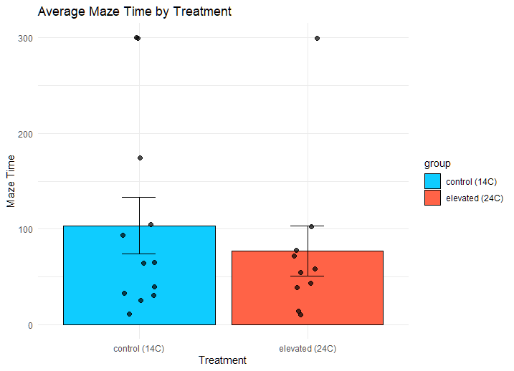
Average maze times:
Control group took ~25% longer on average
Food was found 86% of the time
Dots at very top are crabs that didn’t find food

Slide 10
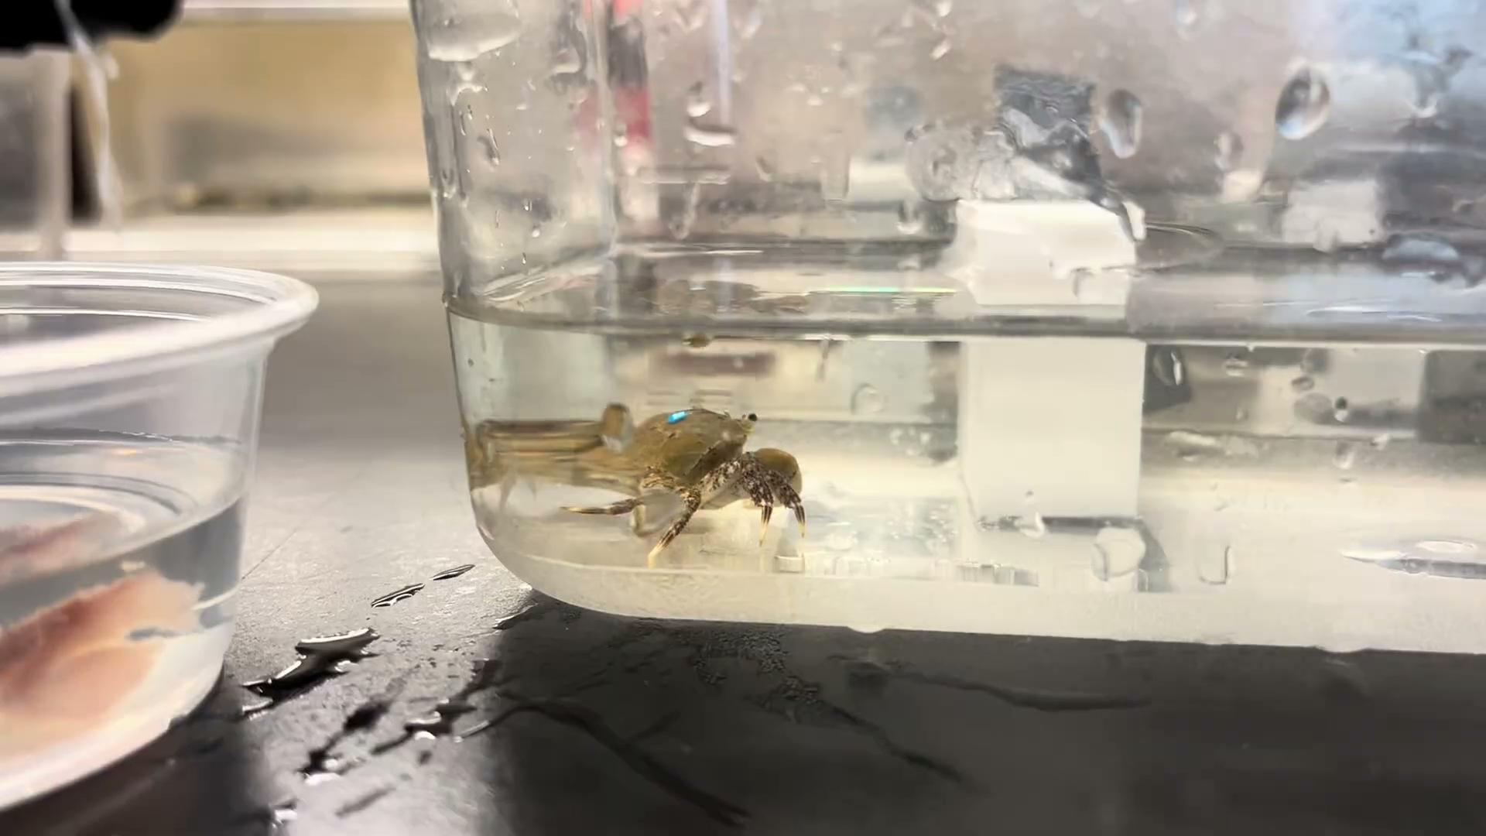

Slide 11
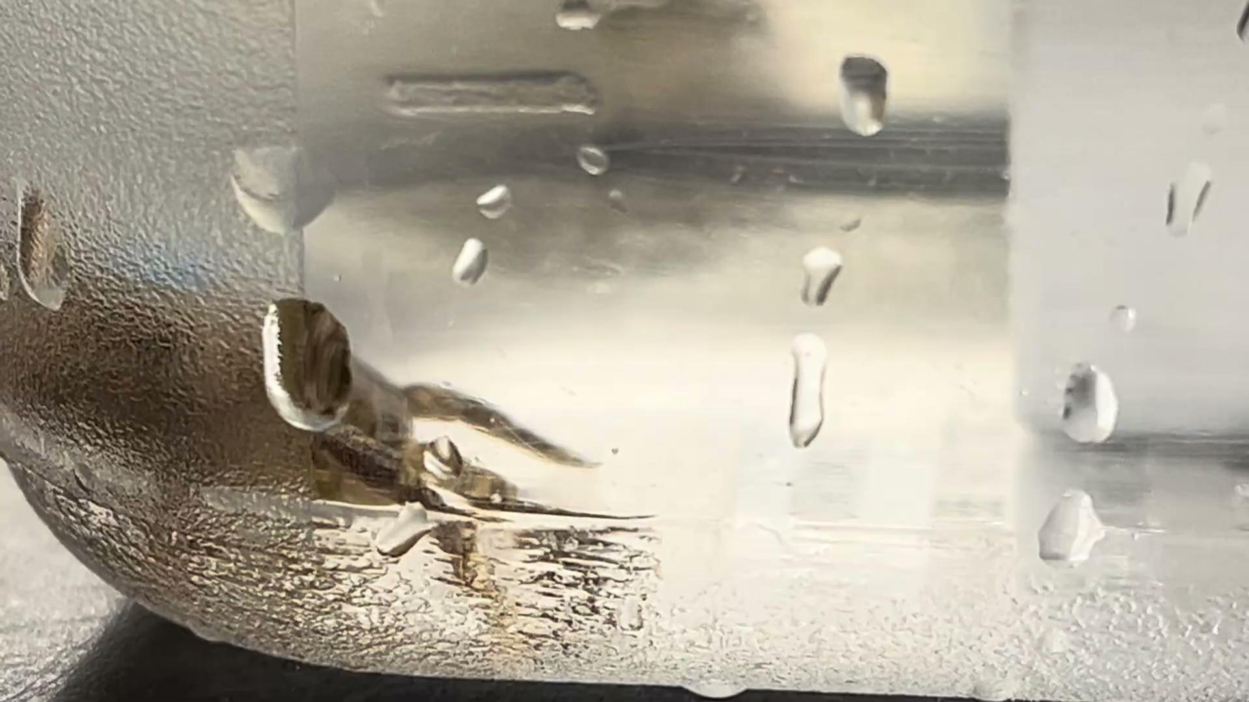

Slide 12
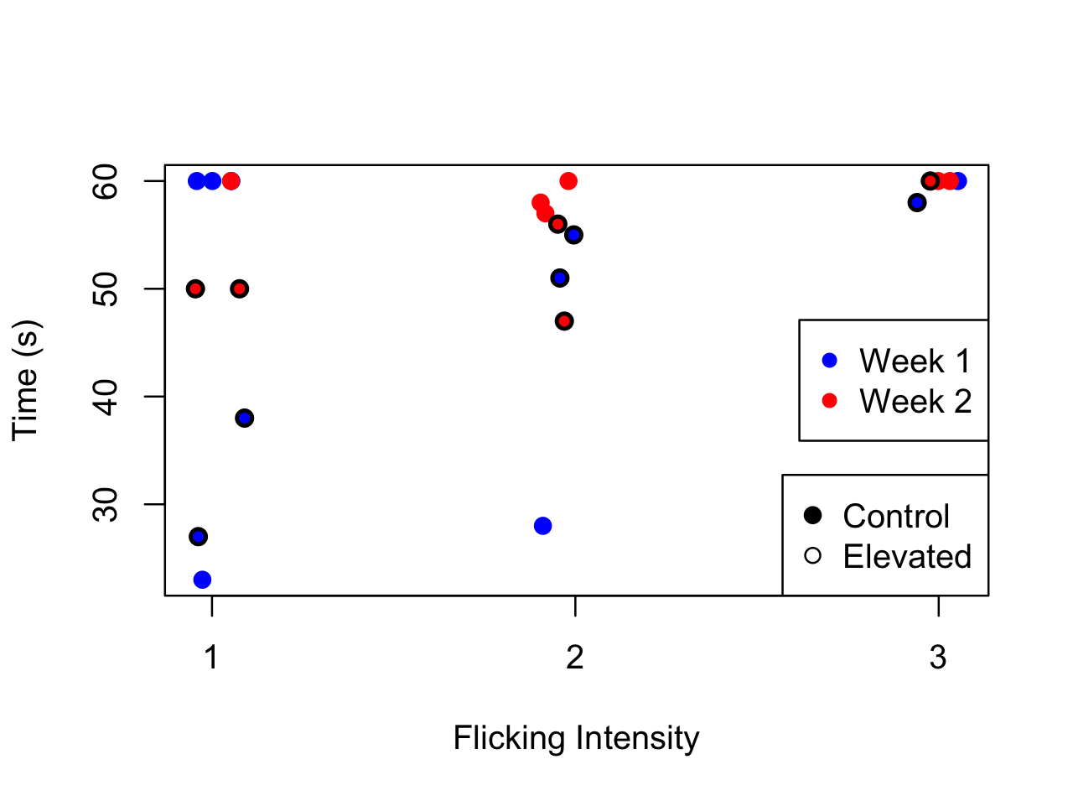
Time and intensity of antennule flicking:
Most crabs flicked close to the entire time
Average flicking time = 51 seconds
3=fast intensity
1=slow intensity

Slide 13
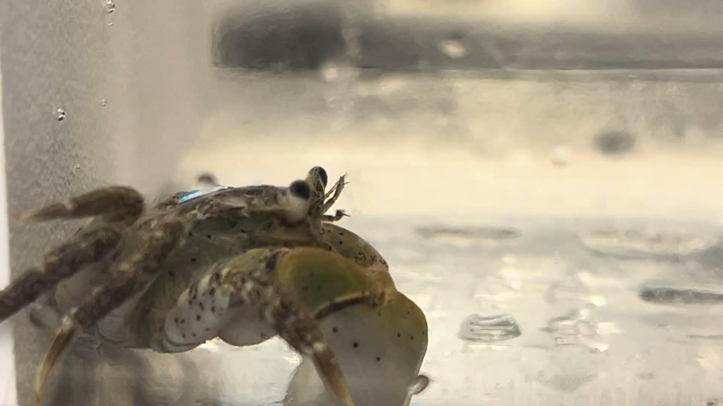

Slide 14
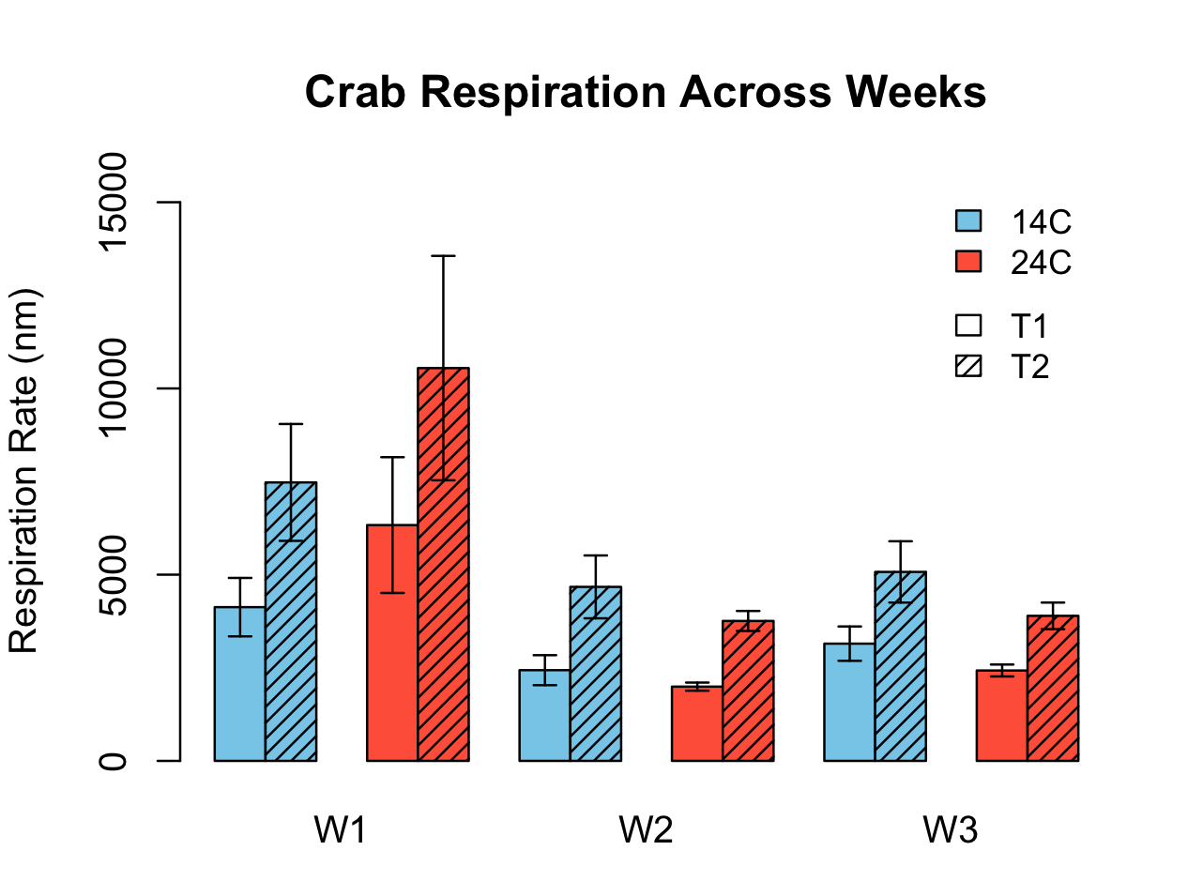
Respirometry across weeks:
First week rates were ~2x higher compared to other weeks
W2 & W3 cold groups minorly higher than elevated groups

Slide 15
Discussion:
Caveats/limitations:
Crab 12 mortality: consumed by groupmates (unfasted for week 2 trials)
Handling stress, sex of crabs, size standardization, etc
High temp tank still within thermal tolerance window?
Small sample size
Respirometry:
Comparable respirometry rates across temperature groups
Signs of acclimation, since heightened temperatures increase metabolic rate
Flicking rate:
Some difference (diminished) flicking time in testing group: temperature effects on degree of olfactory response not measurable here?

Slide 16
Discussion:
Future directions:
Do H. oregonensis recognize C. maenas’ cues as predator cues?
Temperature in conjunction with other anthropogenic stressors (pH, microplastics, etc)
Comparative physiology between H. oregonensis and C. maenas: differences in chemoreception under stress?
Long-term impairment to chemoreception: different effects across ontogeny?
Similar experimental setup with larger sample size, more intense thermal stress, fasted conditions.

Slide 17
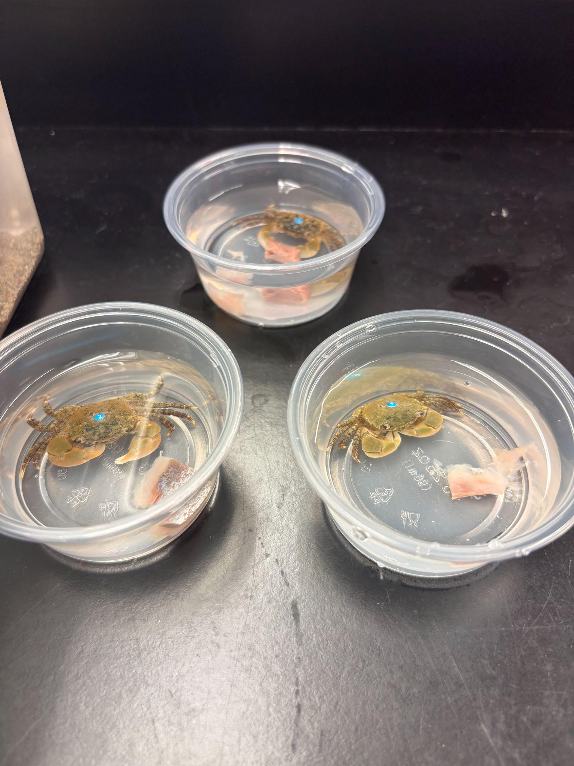
Questions? Thank You!

